Slide 1
AVIONICS TEAM Weekly progress report
Presented by CALEB MUCHERU

Slide 2
Tasks completed this week
[# Issue 3]: ESP32 CAM
[# Issue 4]: FPV 1200tvl camera
[# Issue 83]: Design of power distribution board
[# Issue 119]: Develop test stand and ground station software
[# Issue 120]: Test stand and ground station software
[# Issue 143]: Test flight PCB
[# Issue 147]: Test stand backend services
[# Issue 149]: Test avionics system for test flight

Slide 3
POWER DISTRIBUTION BOARD
We redesigned the power distribution board to incorporate supplies for the ejections, cameras and the BLDC motor.
After review, the flight control team recommended us to add super-capacitors for cater for the ejection charge.
Voltage regulator transistor circuit AO3401A was replaced with DMN2009USS-13 to sustain the peak currents of the BLDC motor.

Slide 4
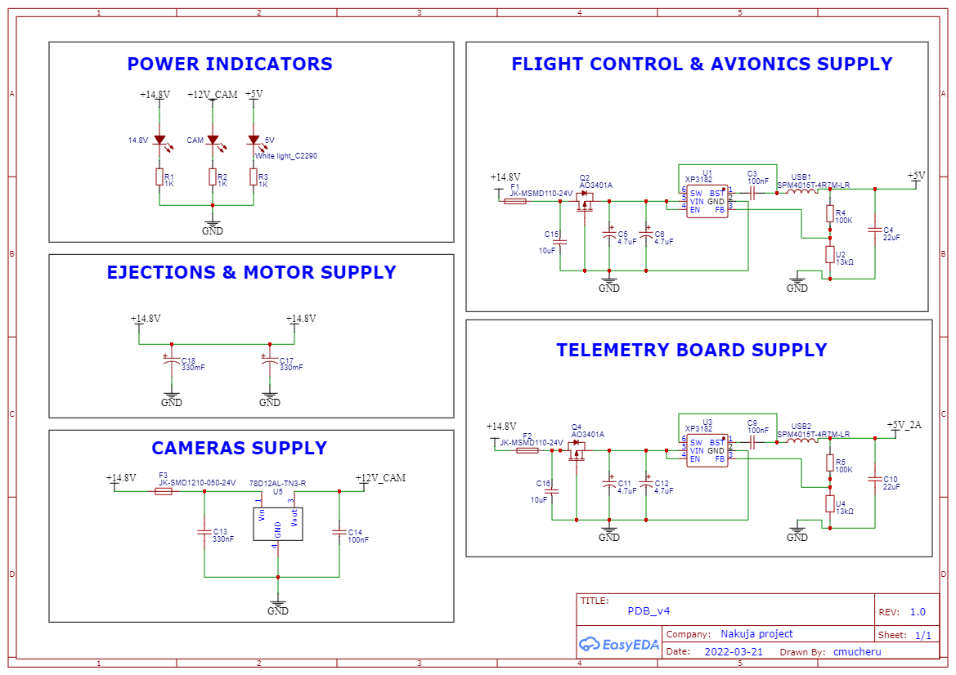
POWER DISTRIBUTION BOARD SCHEMATIC

Slide 5
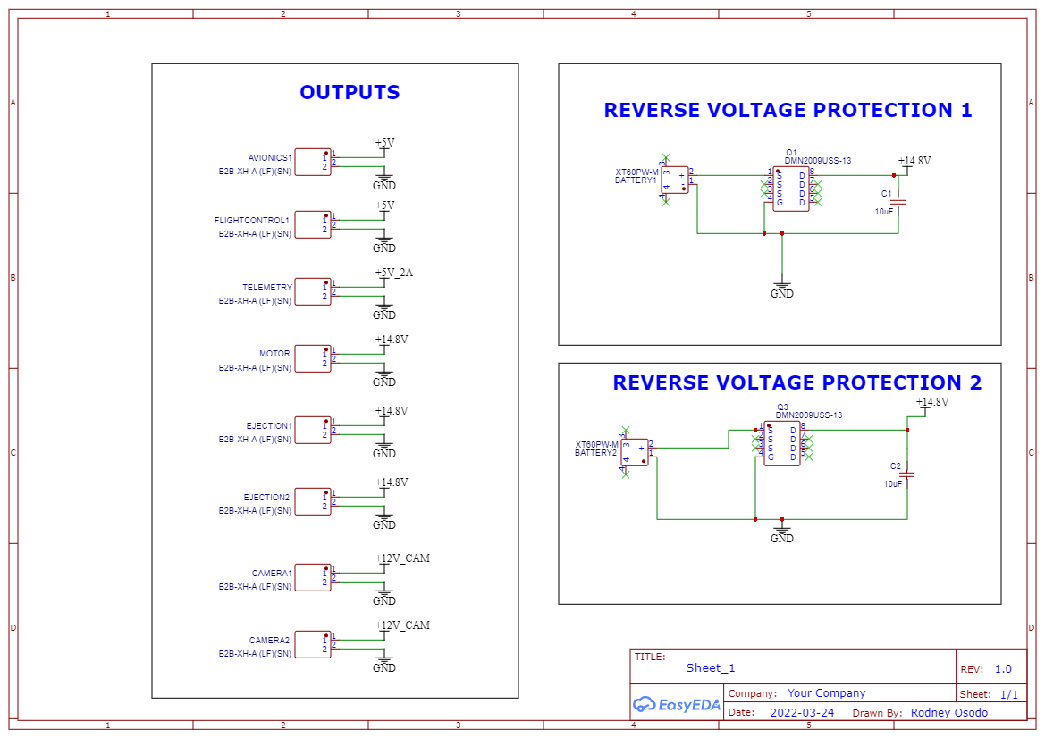
CONNECTIONS

Slide 6
ESP32 CaM and Fpv 1200tvl
The ESP32 CAM worked. It worked well with time lapses.
For the FPV 1200tvl camera, we are collecting connectors i.e. HDMI to I2S converters.
We found a composite to HDMI. We are looking for the capture card. These will be integrated to the FPV 1200tvl cam setup.

Slide 7
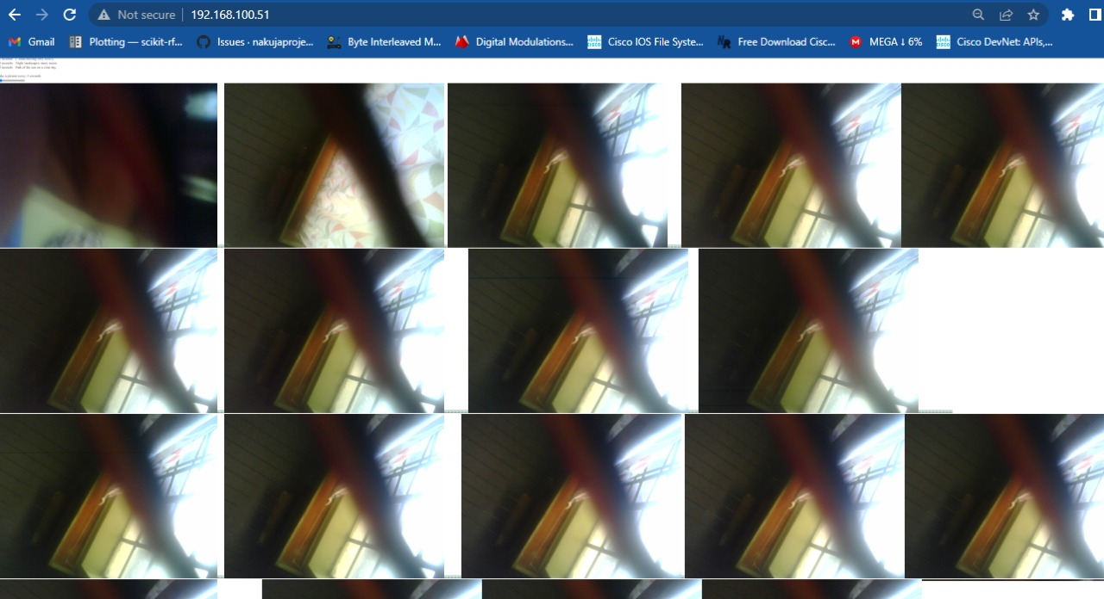
ESP32 CAM RECORDED PHOTOS

Slide 8
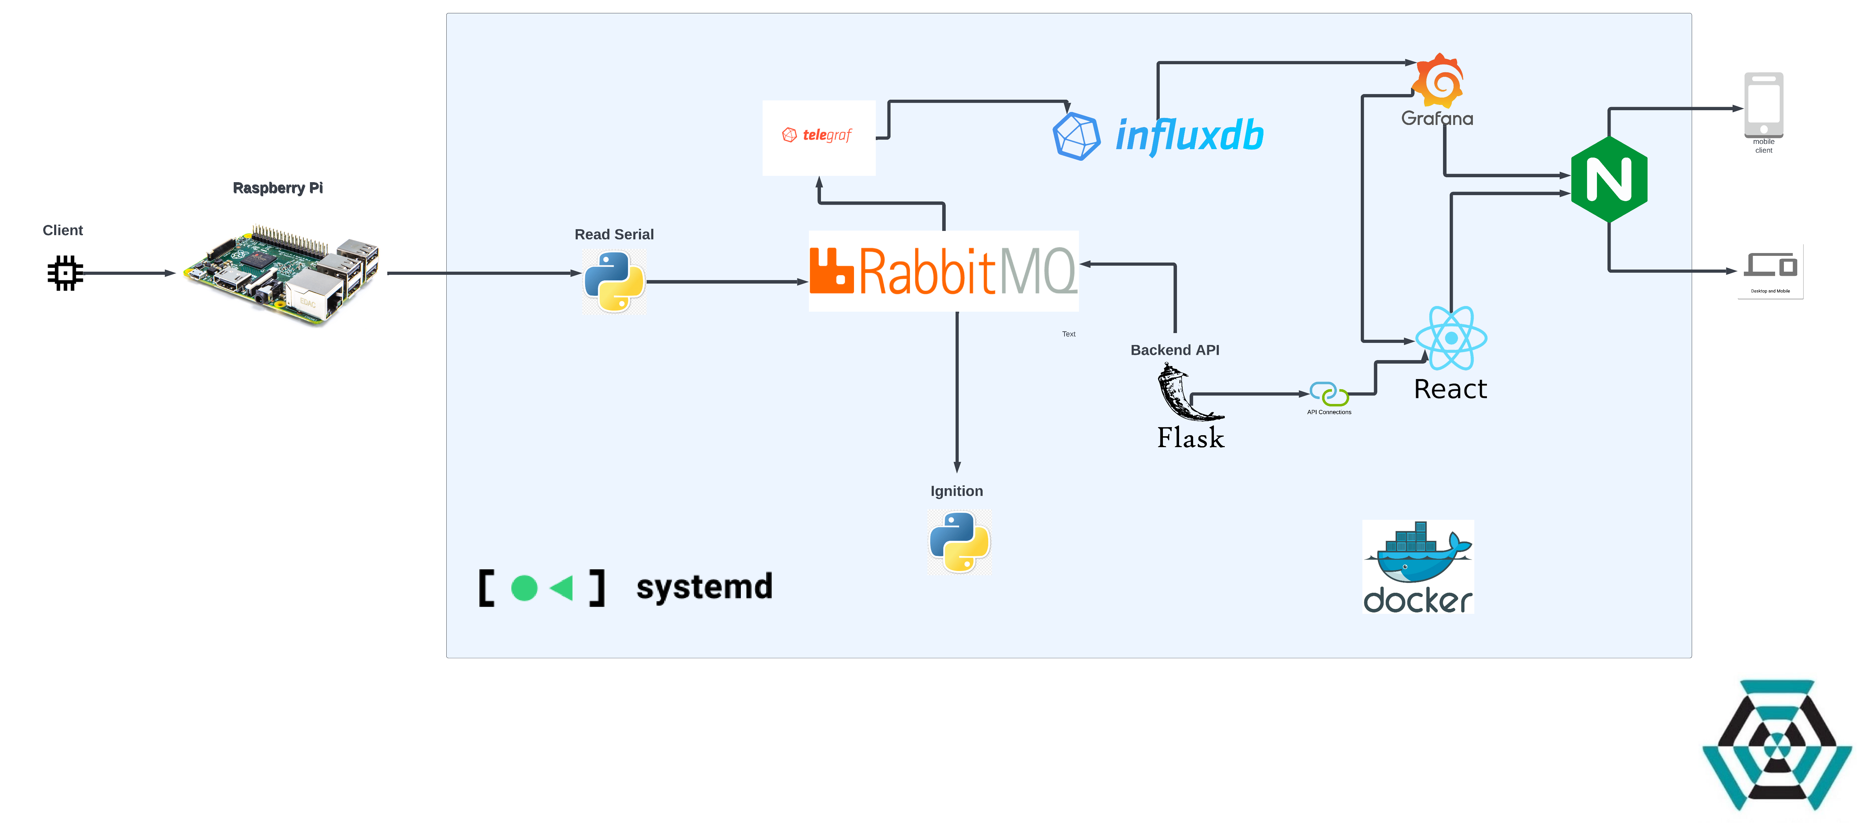
Test stand and ground station software

Slide 9
TEST FLIGHT PCB
Fabrication of the PCB for the test flight was completed.

Slide 10
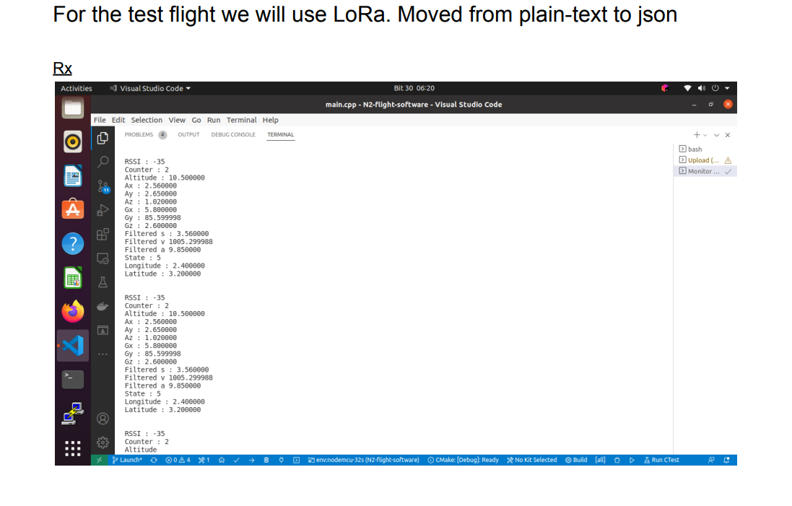
TESTING AVIONICS SYSTEM FOR TEST FLIGHT

Slide 11
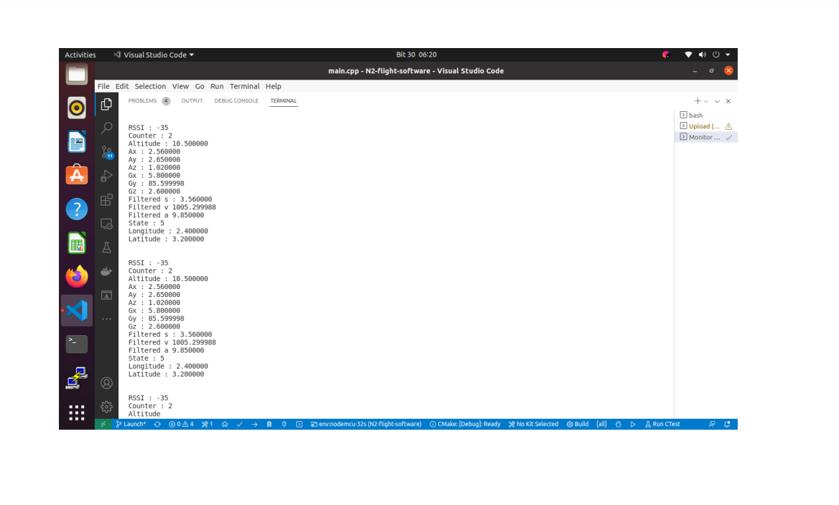
TX

Slide 12
TASKS IN PROGRESS
[# Issue 145]: Ordering of the telemetry PCBA
[# Issue 148]: Printing of Yaggi-Udda antenna
[# Issue 149]: Testing avionics system on test flight
[# Issue 150]: Test flight

Slide 13
TASKS THIs WEEK
1 Test flight
2 Integration of cameras; esp32 and FPV 1200tvl

